Slide 1




EPICS on the web with
REACT.js / Socket.io / Node.js
Dr. David Michel

Slide 2

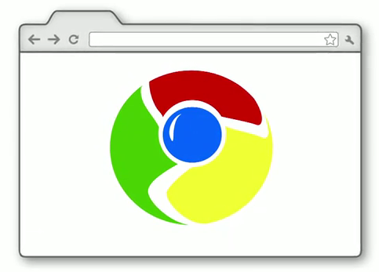

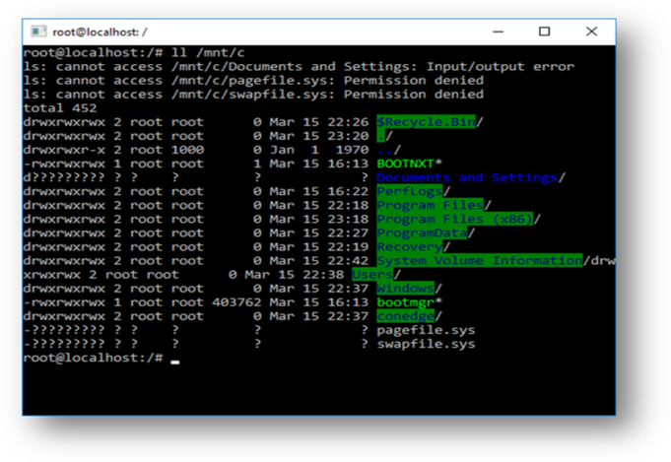


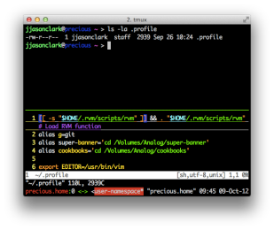
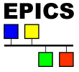

IOC
IOC
IOC

Slide 3
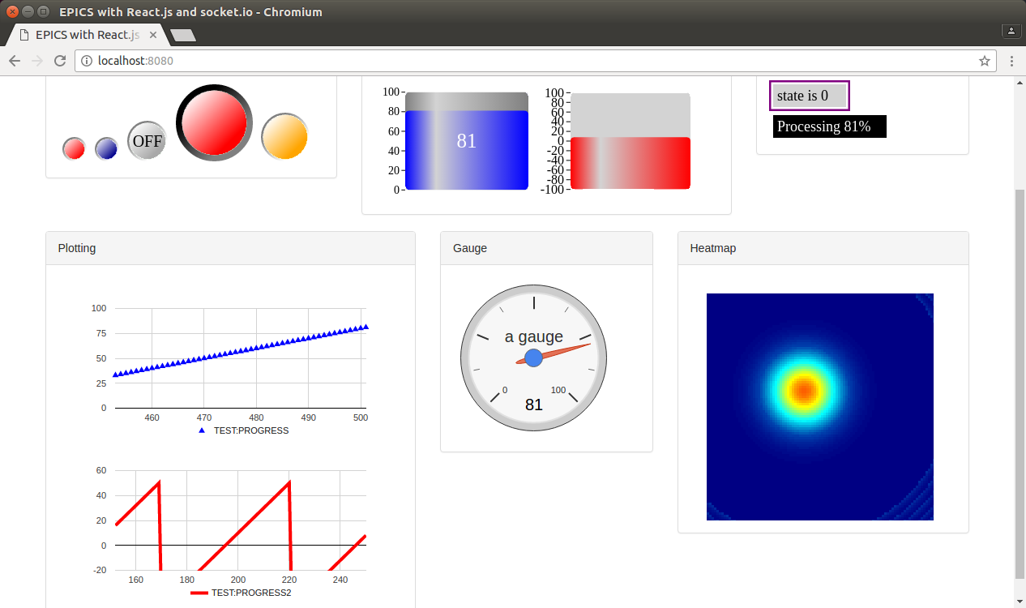
Browser (as a client) registers with Node.js server
Widget made with HTML5 Canvas as REACT components
Easy to write HTML page
<Led pv="TEST:BLINK" oncolor="blue" offcolor="darkblue"/>

Slide 4

What’s on the TODO list?
Widget Performance
Add More widgets
Currently only works on PV value… should add units, limits, etc.
Smart Node.js server with load balancing

Slide 5
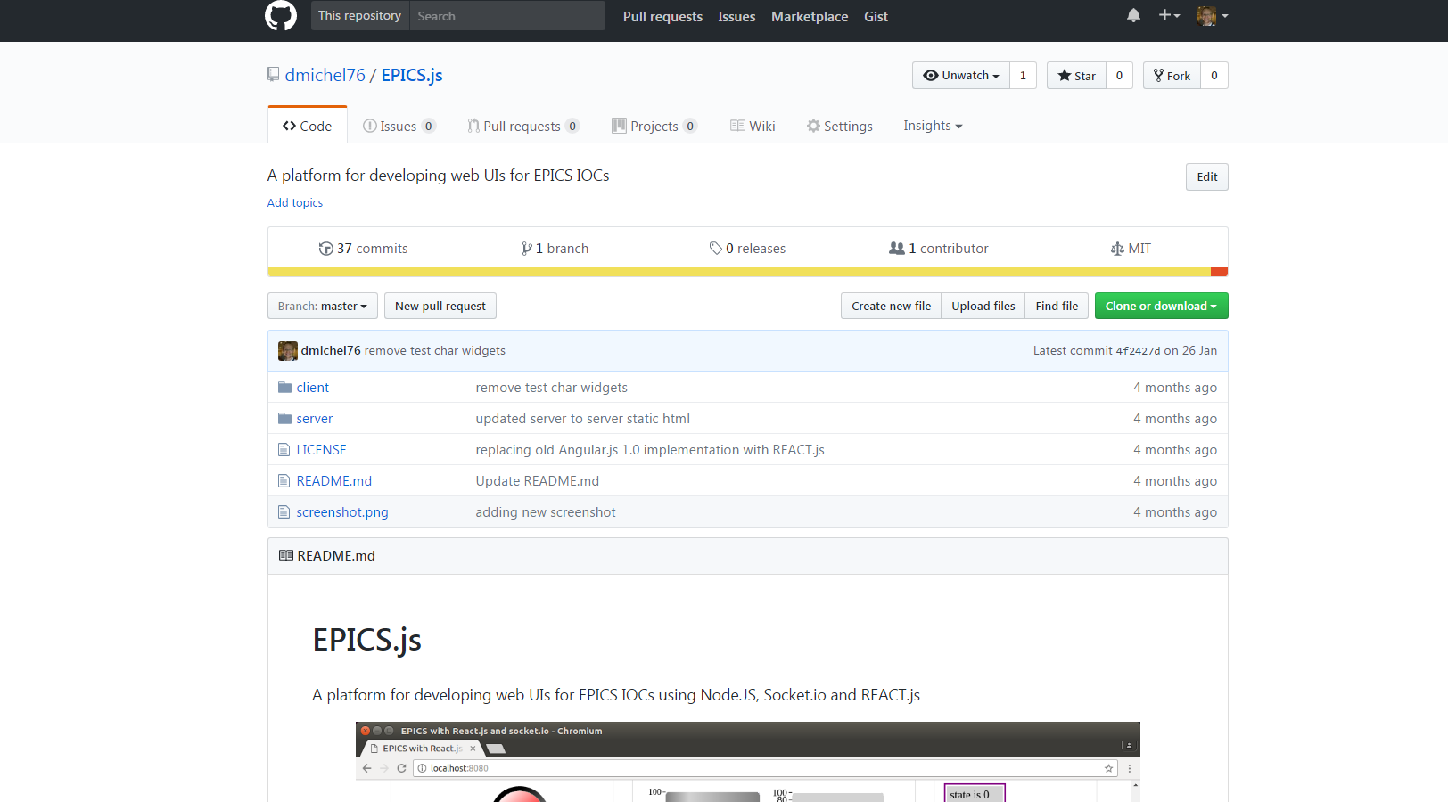

Slide 6


david.michel@tessella.com
?
david.michel@stfc.ac.uk

